Slide 1

Artificial Intelligence in Aviation
Defınetıon &sample of aı,threaths and opportunıtıes OF aI ın the avıatıon ındustry

Slide 2
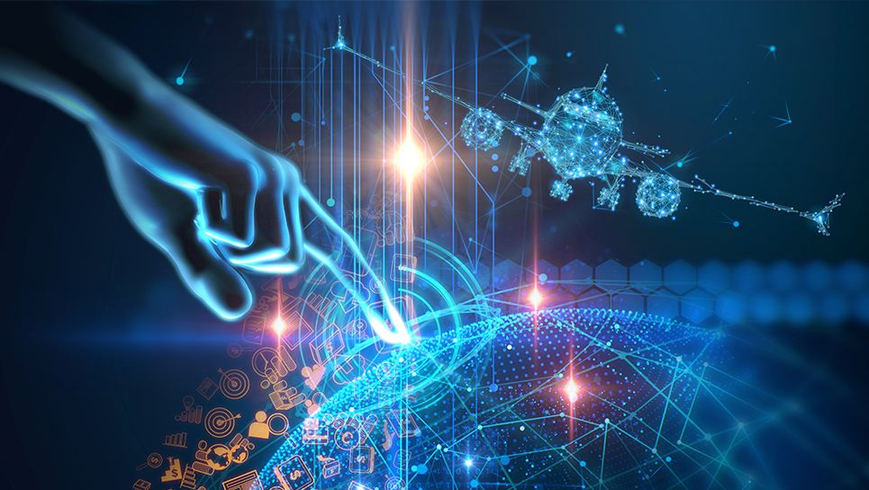
AYÇA UÇAR
STUDENT AT ANKARA UNIVERSITY
COMPUTER ENGINEERING

Slide 3
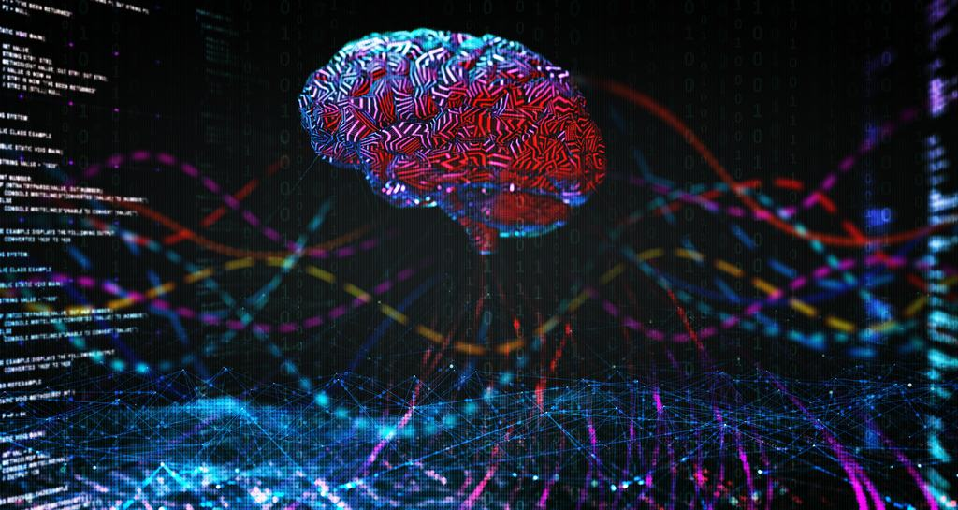
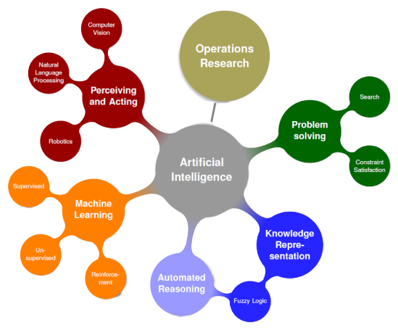
The Artificial Intelligence
In simple terms, AI is the simulation of human intelligence by computers. It relates to the ability to learn, rationalize and undertake appropriate actions to achieve a specific goal. [1]

Slide 4
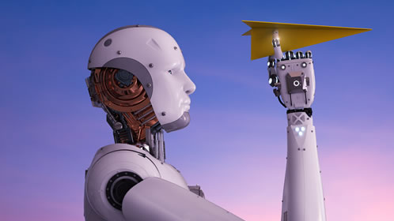
Executing Process of AI
Human intelligence
perception-cognition-action computing cycle
Individuals perceive something in the world around them, think about what to do, and then, once they weigh the options, make a decision.
A computer
The important thing is that he can constantly update and reconfigure the world model he creates.

Slide 5
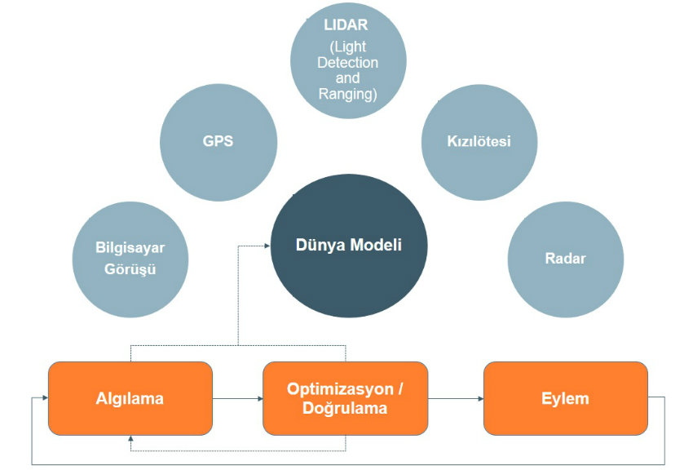
The model of the world in which autonomous IHA navigation works; includes maps showing preferred routes, altitude barriers and no-fly zones.
GPS coordinates are sent to the IHA because not to take the IHA into a no-fly zone or prevent it from colliding with an obstacle.
Radars increase this model in real time, specifying which places are cleared of obstacles.

Slide 6
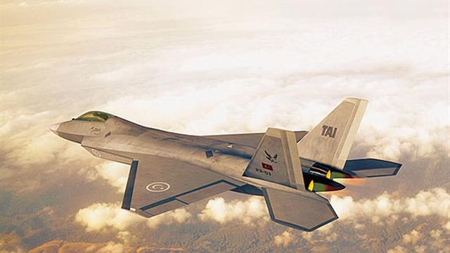
Some Example for AI in Avionics Applications
[2]
AI systems, over time, learn from the data fed to them. Therefore, AI will be able to learn how pilots operate at work and take decisions during a flight. In the absence of a pilot, an AI system can take his place.
Runway overrun prevention systems (ROPS) is a system that assists pilots to make safe decisions while landing an aircraft. With the help of AI, the system can predict the weather conditions enroute to the destination. If the weather conditions are adverse, the system suggests alternate routes to reach the destination. Such suggestions help the aviation industry to enhance its safety.

Slide 7

Fuzzy Logic
Used in the control of IHA for control of a helicopter model.
Radio control by verbal instruction, automatic route entry in inadequate engine situations[3,4].
In the application of maintenance planning for the power system in aircraft,
To improve the safety and reliability of the equipment in aircraft
Determine the possible failure before the failure occurs. This is very important in aviation especially in maintenance activities where companies can make a profit.

Slide 8

Artificial Neural Network
[6]
Target recognition and tracking systems
Performance analysis of new sensors
Radar and image signals processing
Determination of flight trajectories of military aircraft
New types of image signals, including image detection, distinguishing appearance and noise suppression, signal/image identification
High performance of Autopilot in aircraft, flight path parodies, aircraft control systems, increase of Autopilot features, error detectors and parodies of aircraft sections

Slide 9
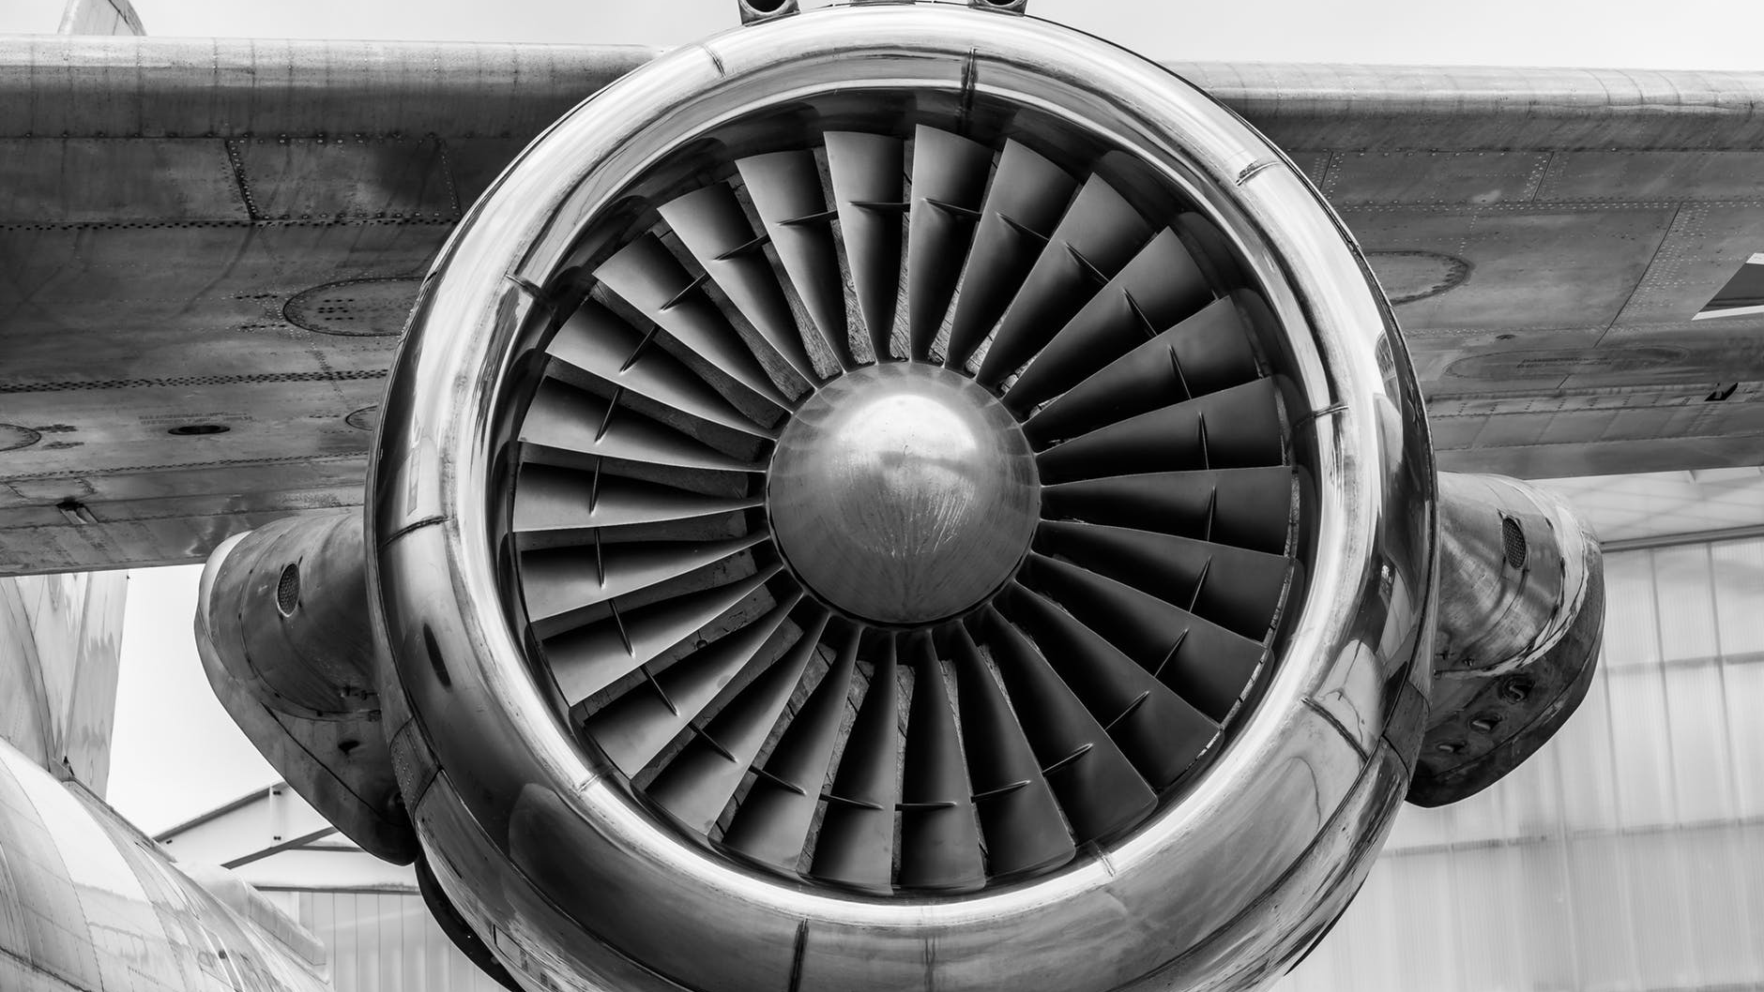
THREATS & OPPORTUNITIES
Based on facts rather than emotions.
Unlike humans, do not need any sleep, thus overcoming the inherent disadvantage of tiredness in humans
Easier spreading of knowledge. After be trained for something, it can be very easily copied to the others.
Lack of common sense and creativity in responses
Any malfunctioning can lead to the AI producing wrong solutions and since it cannot explain the reasoning behind its answer, blind reliance on AI can lead to problems ​
​
It can be used to cause mass scale destruction if given in the wrong hands

Slide 10

REFERENCES
[1} https://news.cgtn.com/news/2019-06-12/Everything-you-need-to-know-about-artificial-intelligence-HswDK6aQdW/index.html
[2]https://www.bbntimes.com/en/technology/artificial-intelligence-and-the-aviation-industry
[3] http://members.tripod.com/~Bagem/bagem/ yz3.html (10.06.2003)
[4]Şenol F., “Bulanık Mantık Kontrolcüsü”, Gazi Ü. Lisans Tezi, Ankara, 2000
[5]OOSTREAM, M., BABUSKA, R., “Virtual Sensor For Fault Detection And Isolation In Flight Control Systems-Fuzzy Modeling Approach”, Proceedings of 39th IEEE Conference on Decision and Control, Sydney, December 2000.
[6]Caner YAĞCI, İlhan GÖKÇE, Tülay BOZÜYÜK, Görkem AKAR, "YAPAY ZEKA TEKNOLOJİSİNİN ENDÜSTRİDEKİ UYGULAMALARI", MARMARA ÜNİVERSİTESİ, İstanbul, 2004

